Slide 1
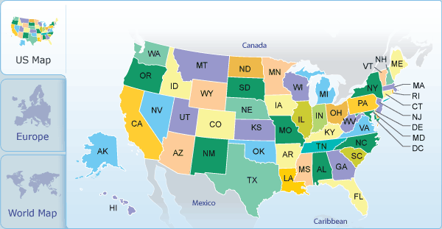
United States of America

Slide 2
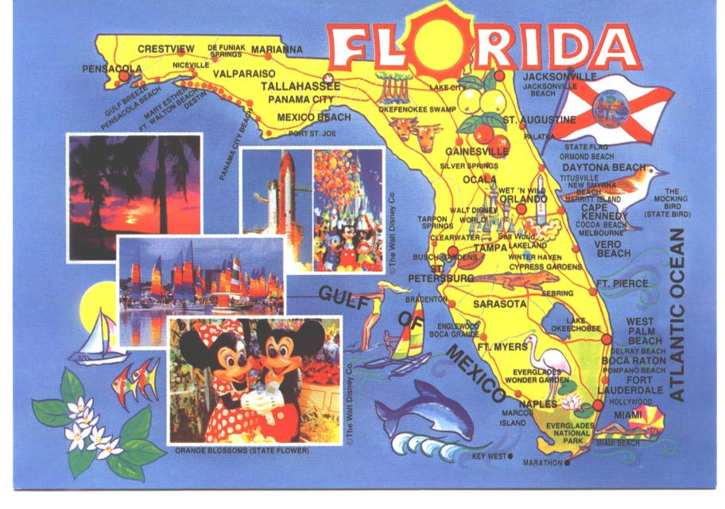
Florida the Sunshine State

Slide 3
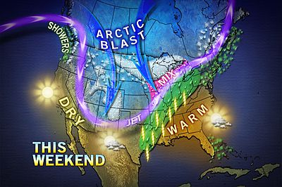
Warm Florida is an International Tourist Destination

Slide 4
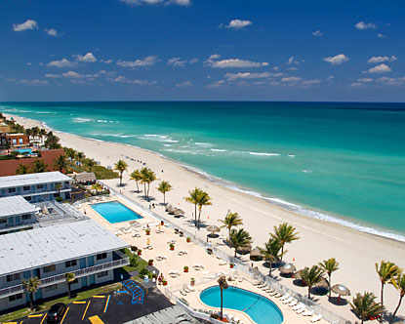
Florida Beaches

Slide 5
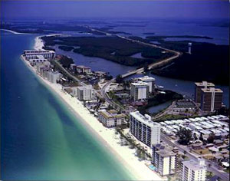
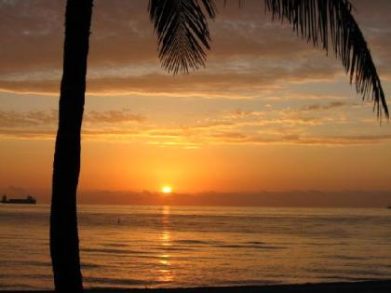
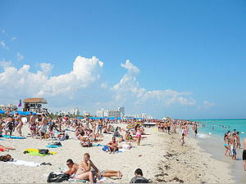
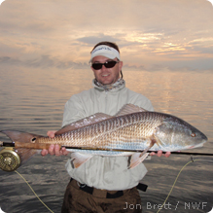
Florida West Coast Gulf of Mexico

Slide 6
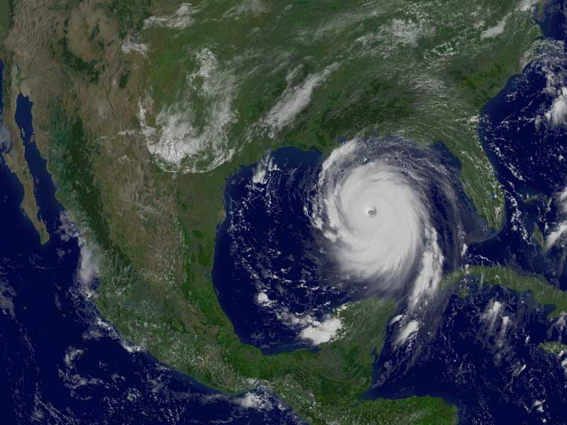
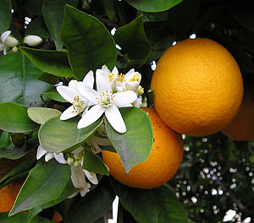
Florida is Sub-Tropical State
Florida is humid subtropical with many citrus fruit and winter vegetables. Hurricanes sometimes arrive during September/October.
Notes:
Florida is a state in the southeastern region of the United States, bordered to the west by the Gulf of Mexico, to the north by Alabama and Georgia and to the east by the Atlantic Ocean. Florida is the 22nd most extensive, the 4th most populous, and the 8th most densely populated of the 50 United States. The state capital is Tallahassee.

Slide 7
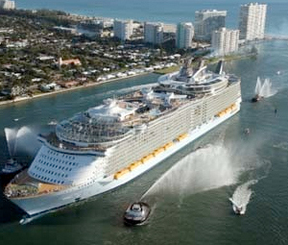



Cruise Ships
NASA Space Center
/
Disney World Resort (Orlando)
Universal Orlando Resort (Orlando)

Slide 8

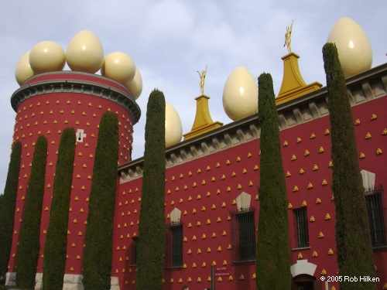
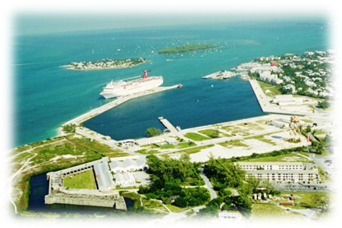
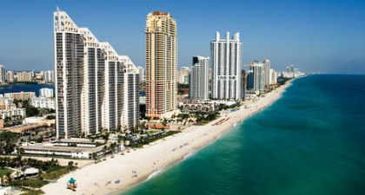

Freedom Tower (Miami)
Dali Museum (St. Petrerburgs)
Skyline de Sunny Isles

Slide 9
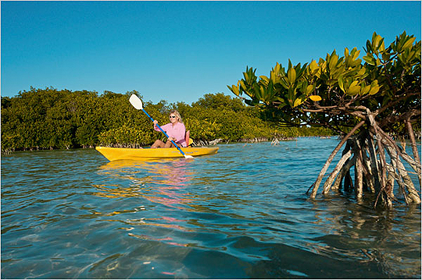


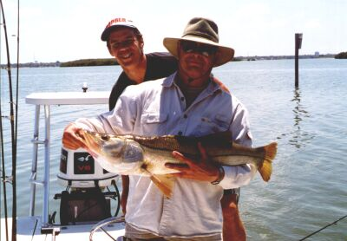
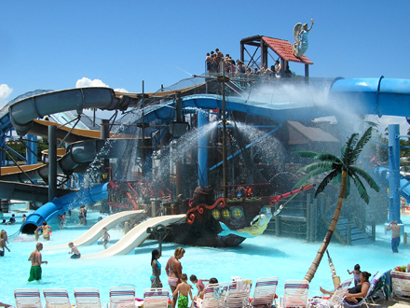
Outdoor Activities

Slide 10
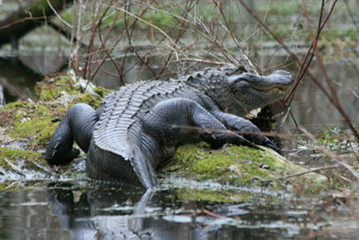

Hunting in Florida

Slide 11
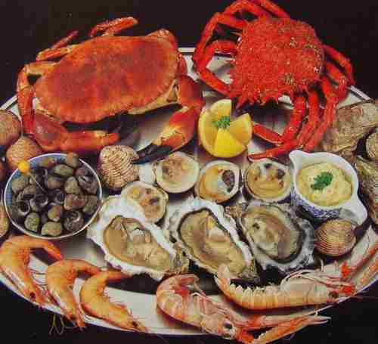
Seafood

Slide 12
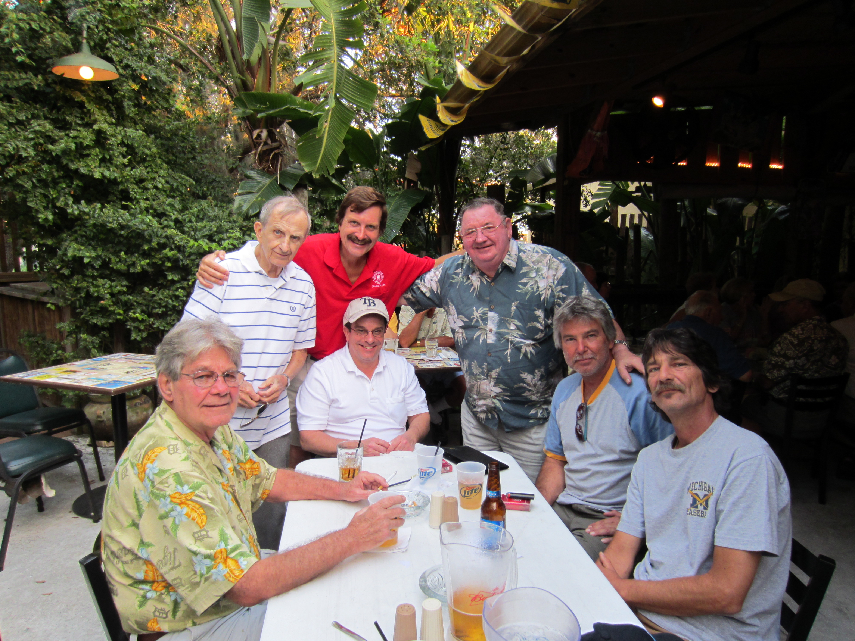
Uncle and Cousins

Slide 13


Dad’s wife Rebecca, Joe, Jeff, Dave Jaye

Slide 14
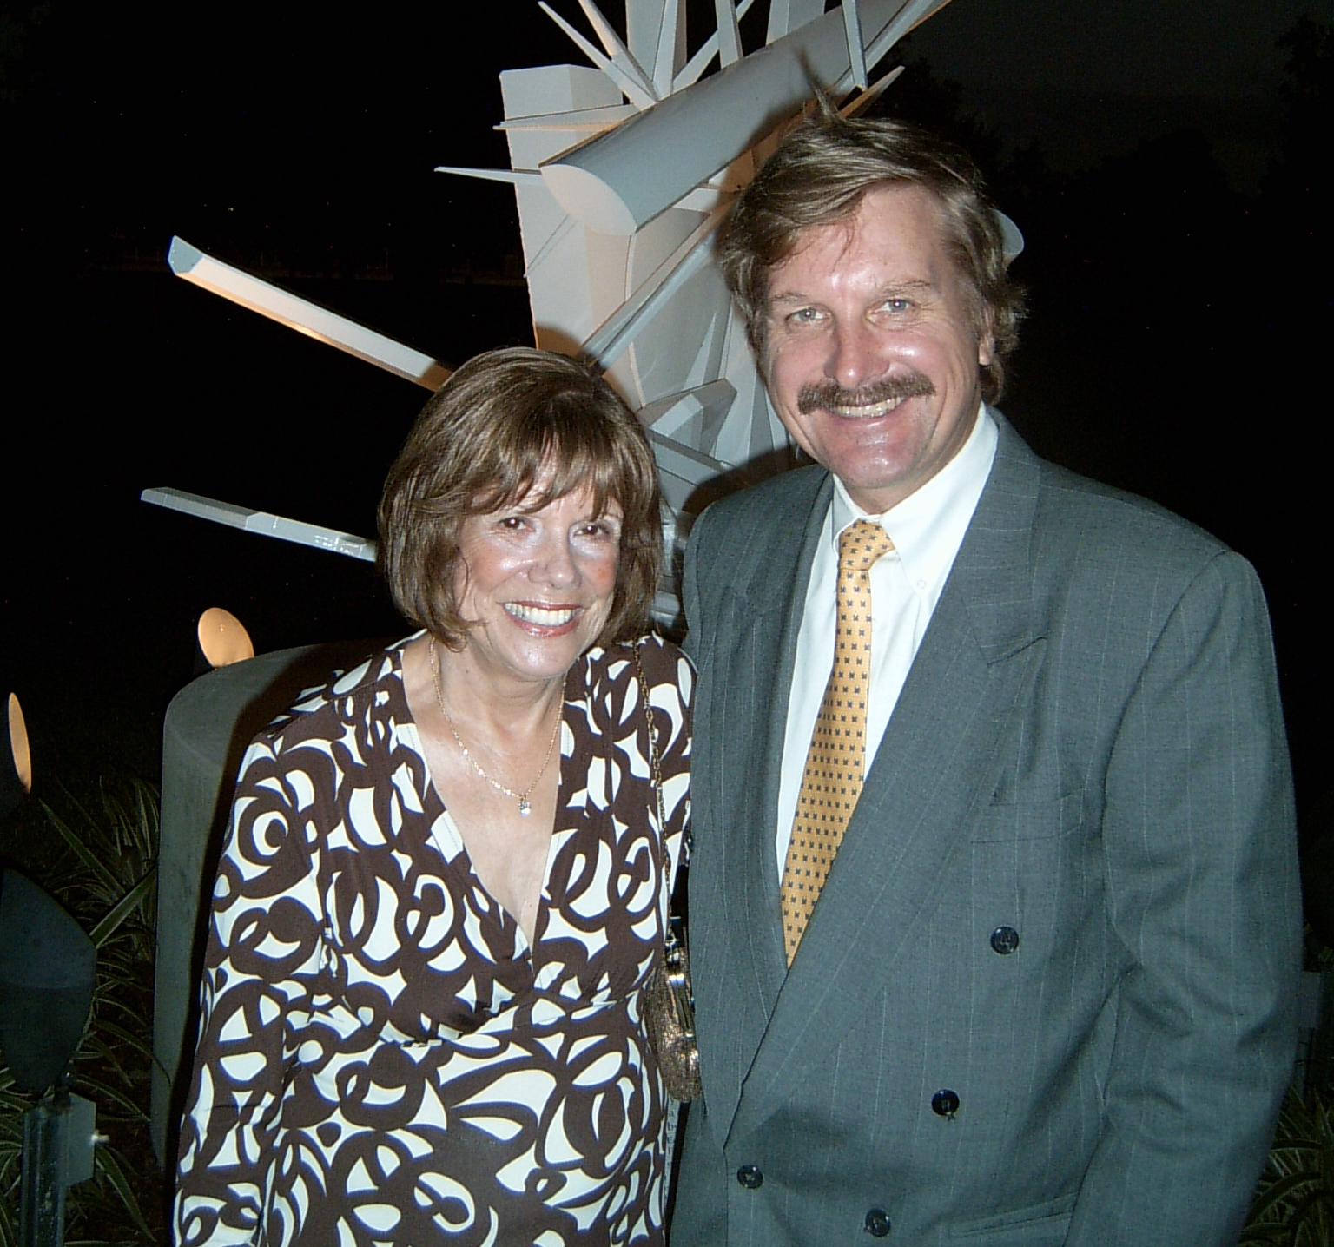
Mom

Slide 15
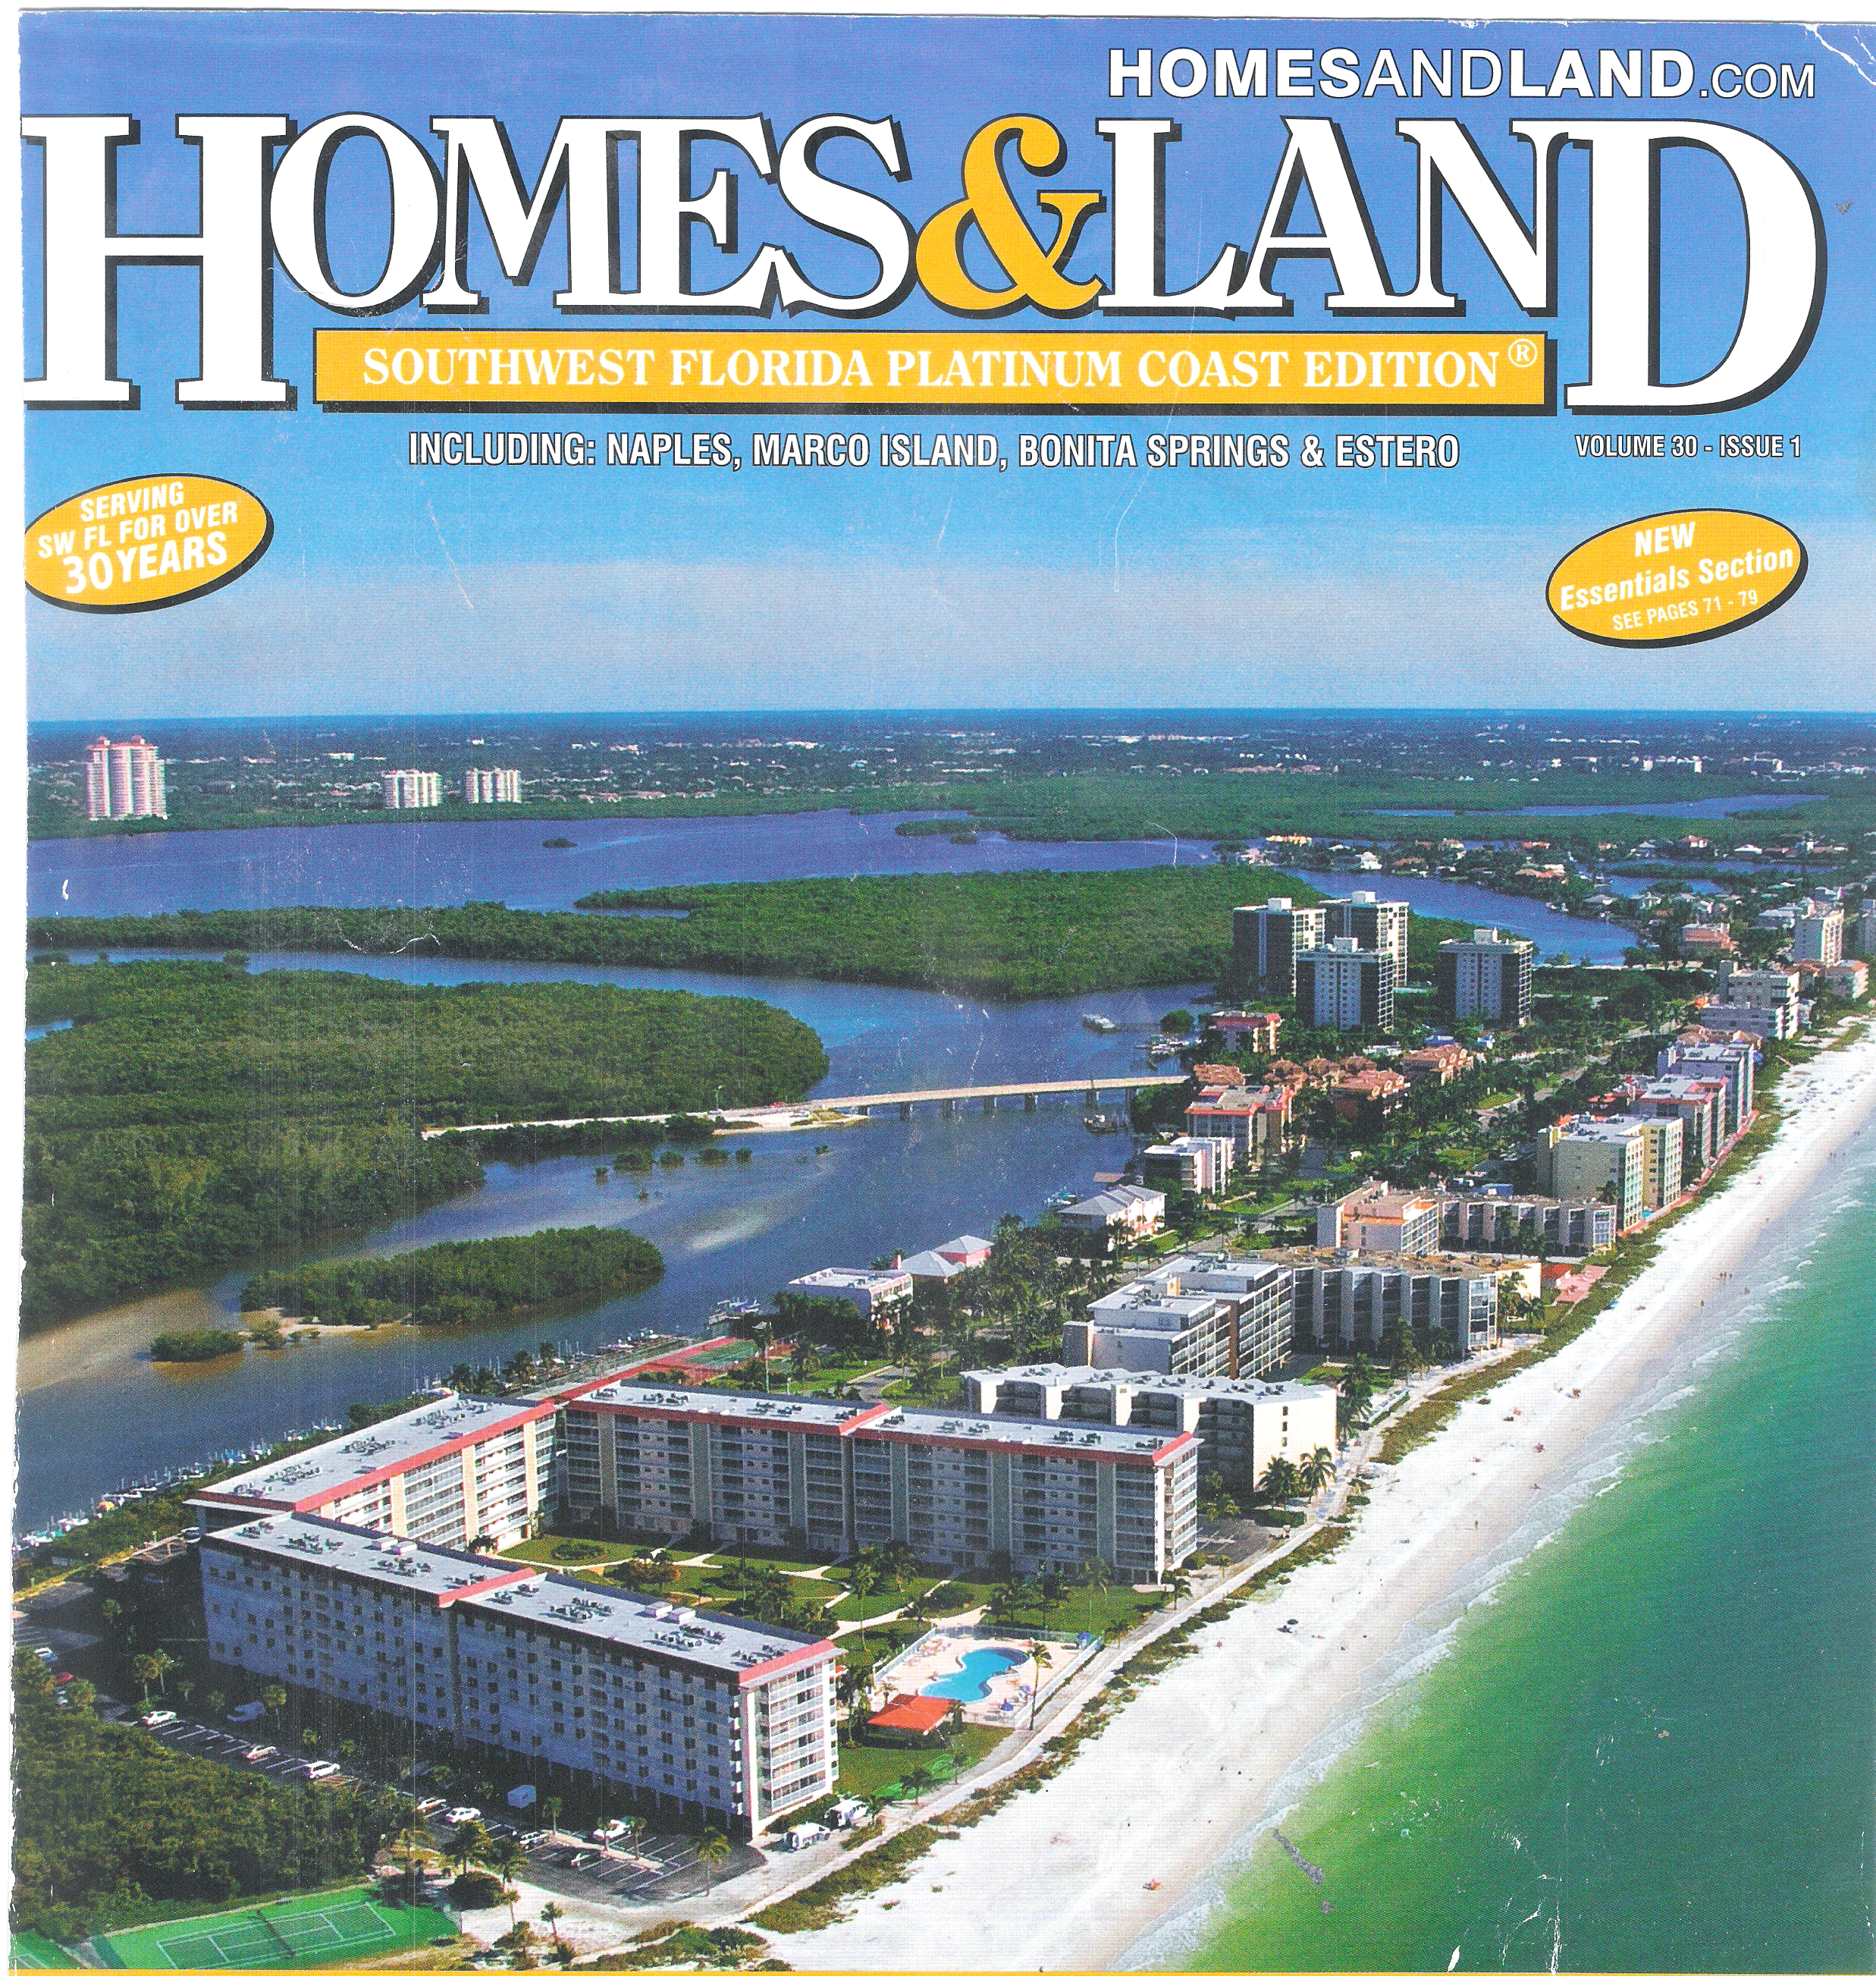
Areal and Beach View of my Condo

Slide 16

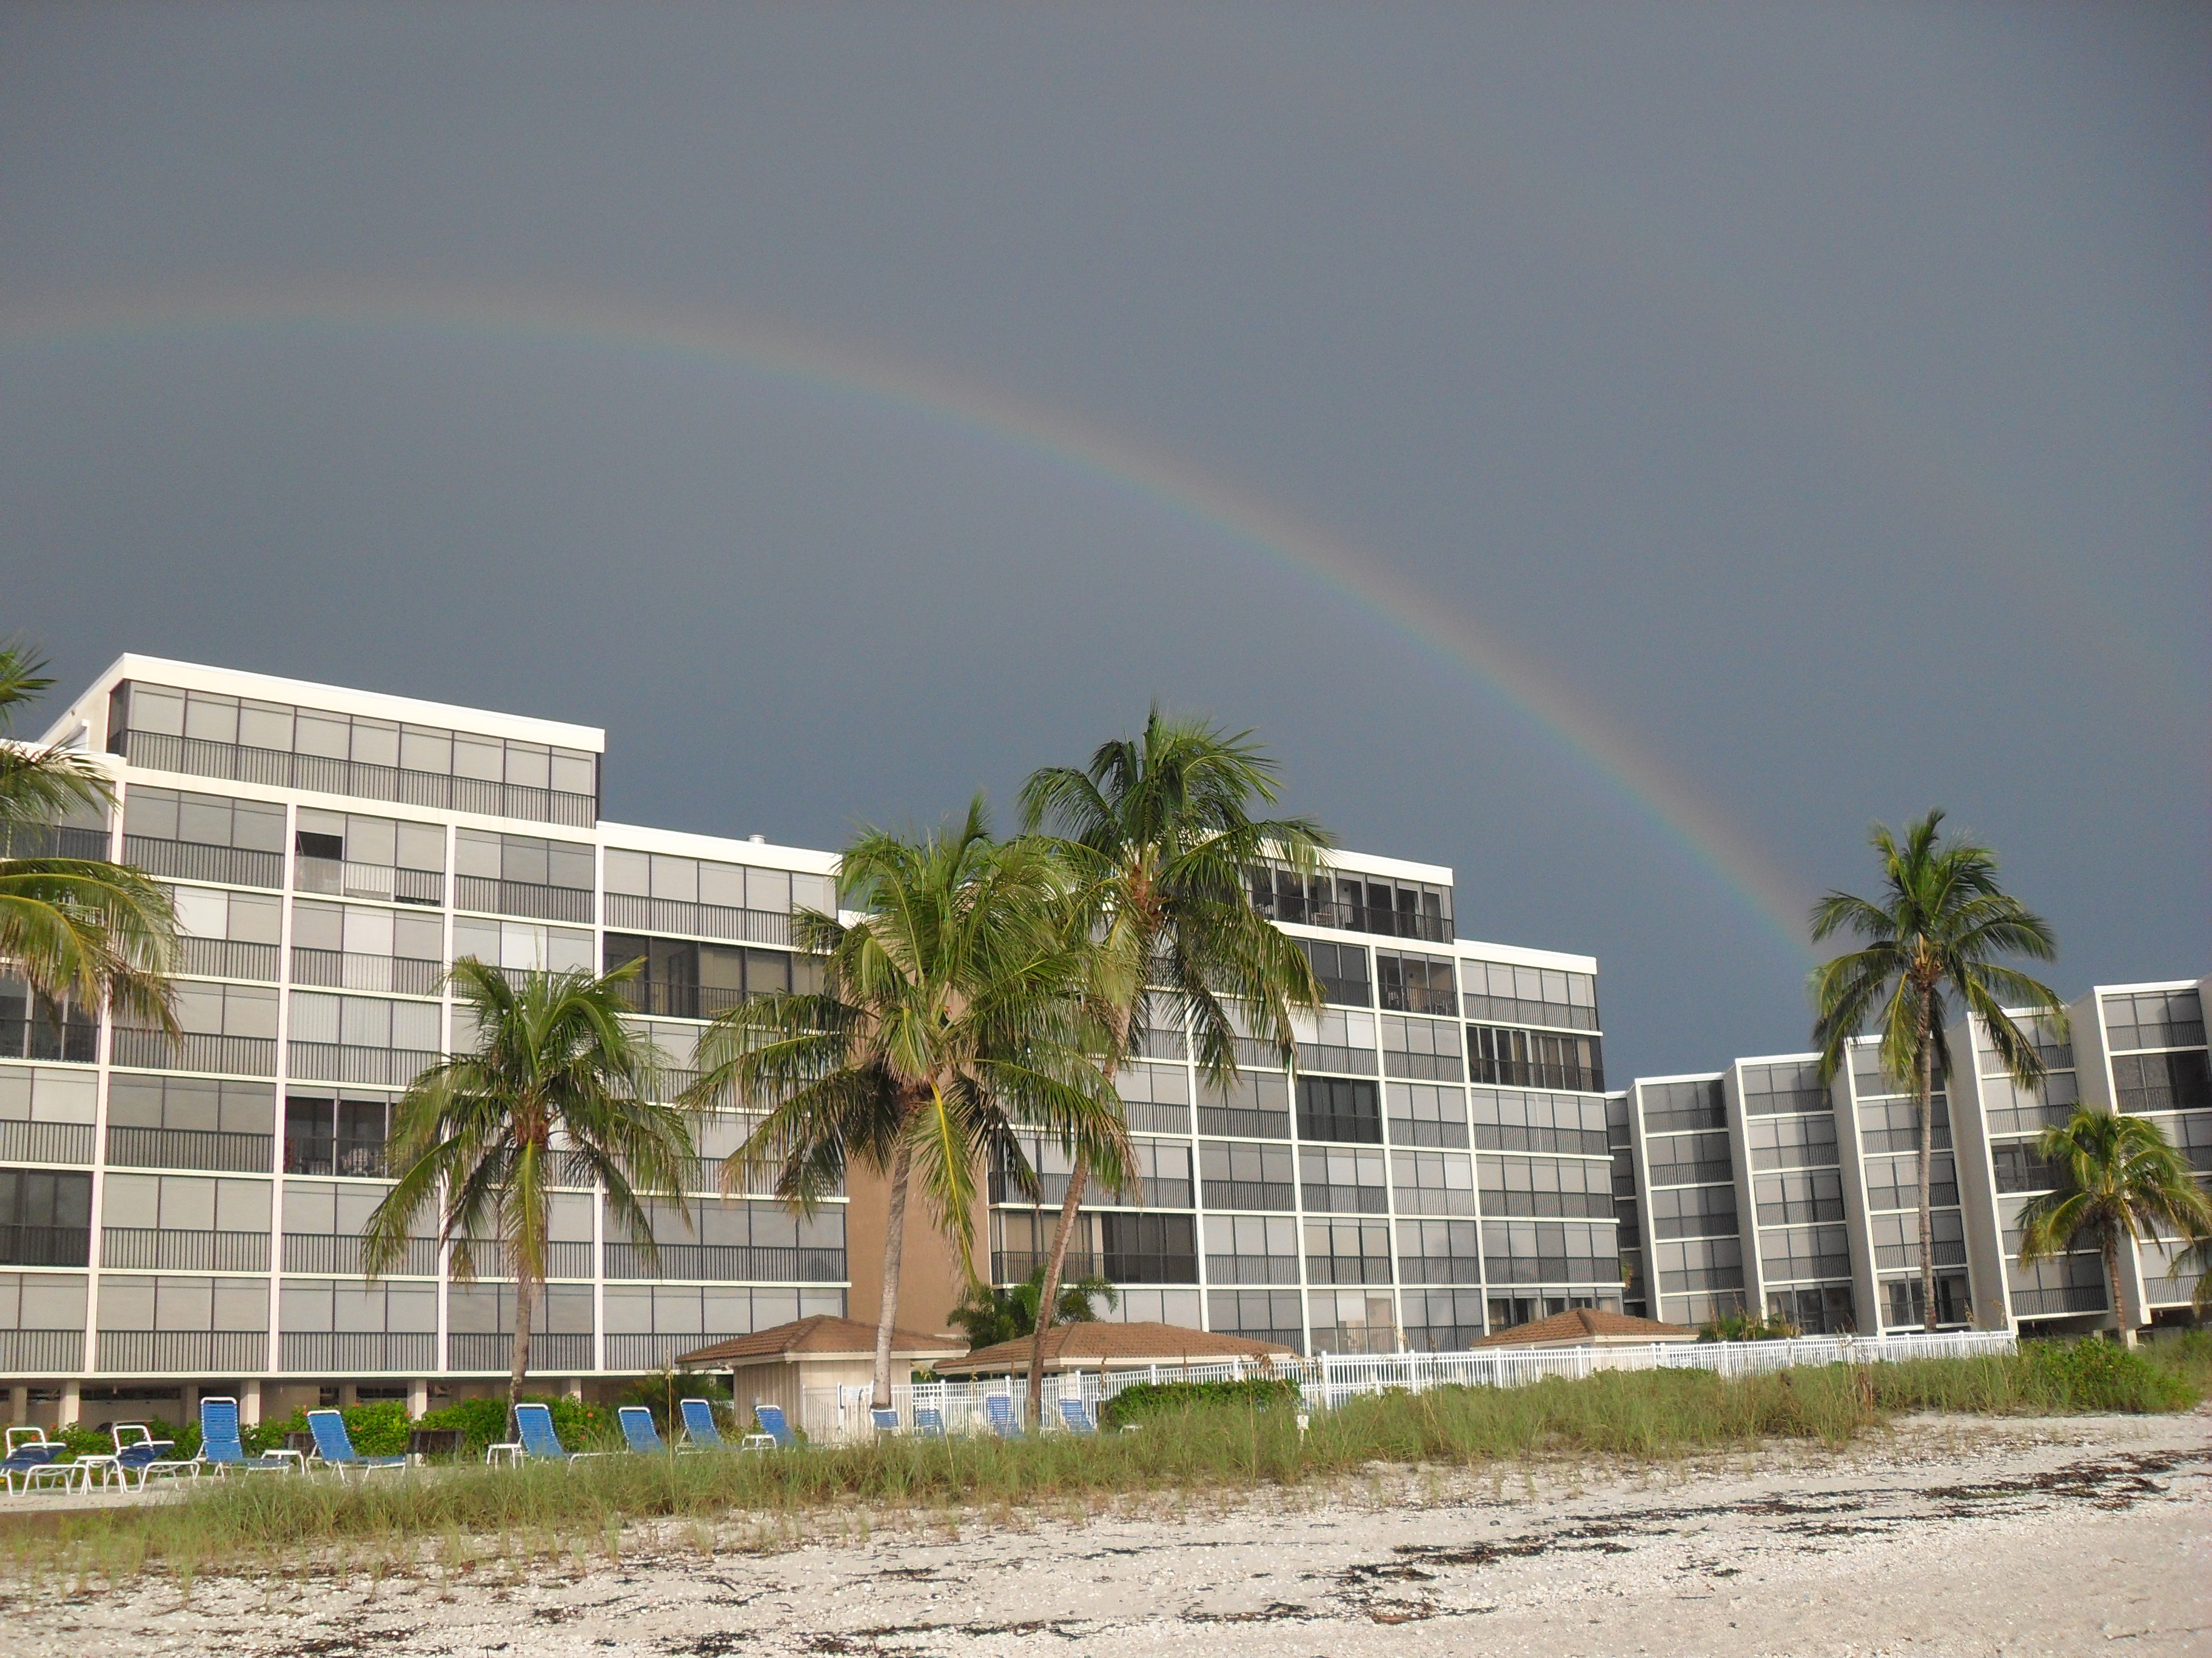
Beach view Condo

Slide 17
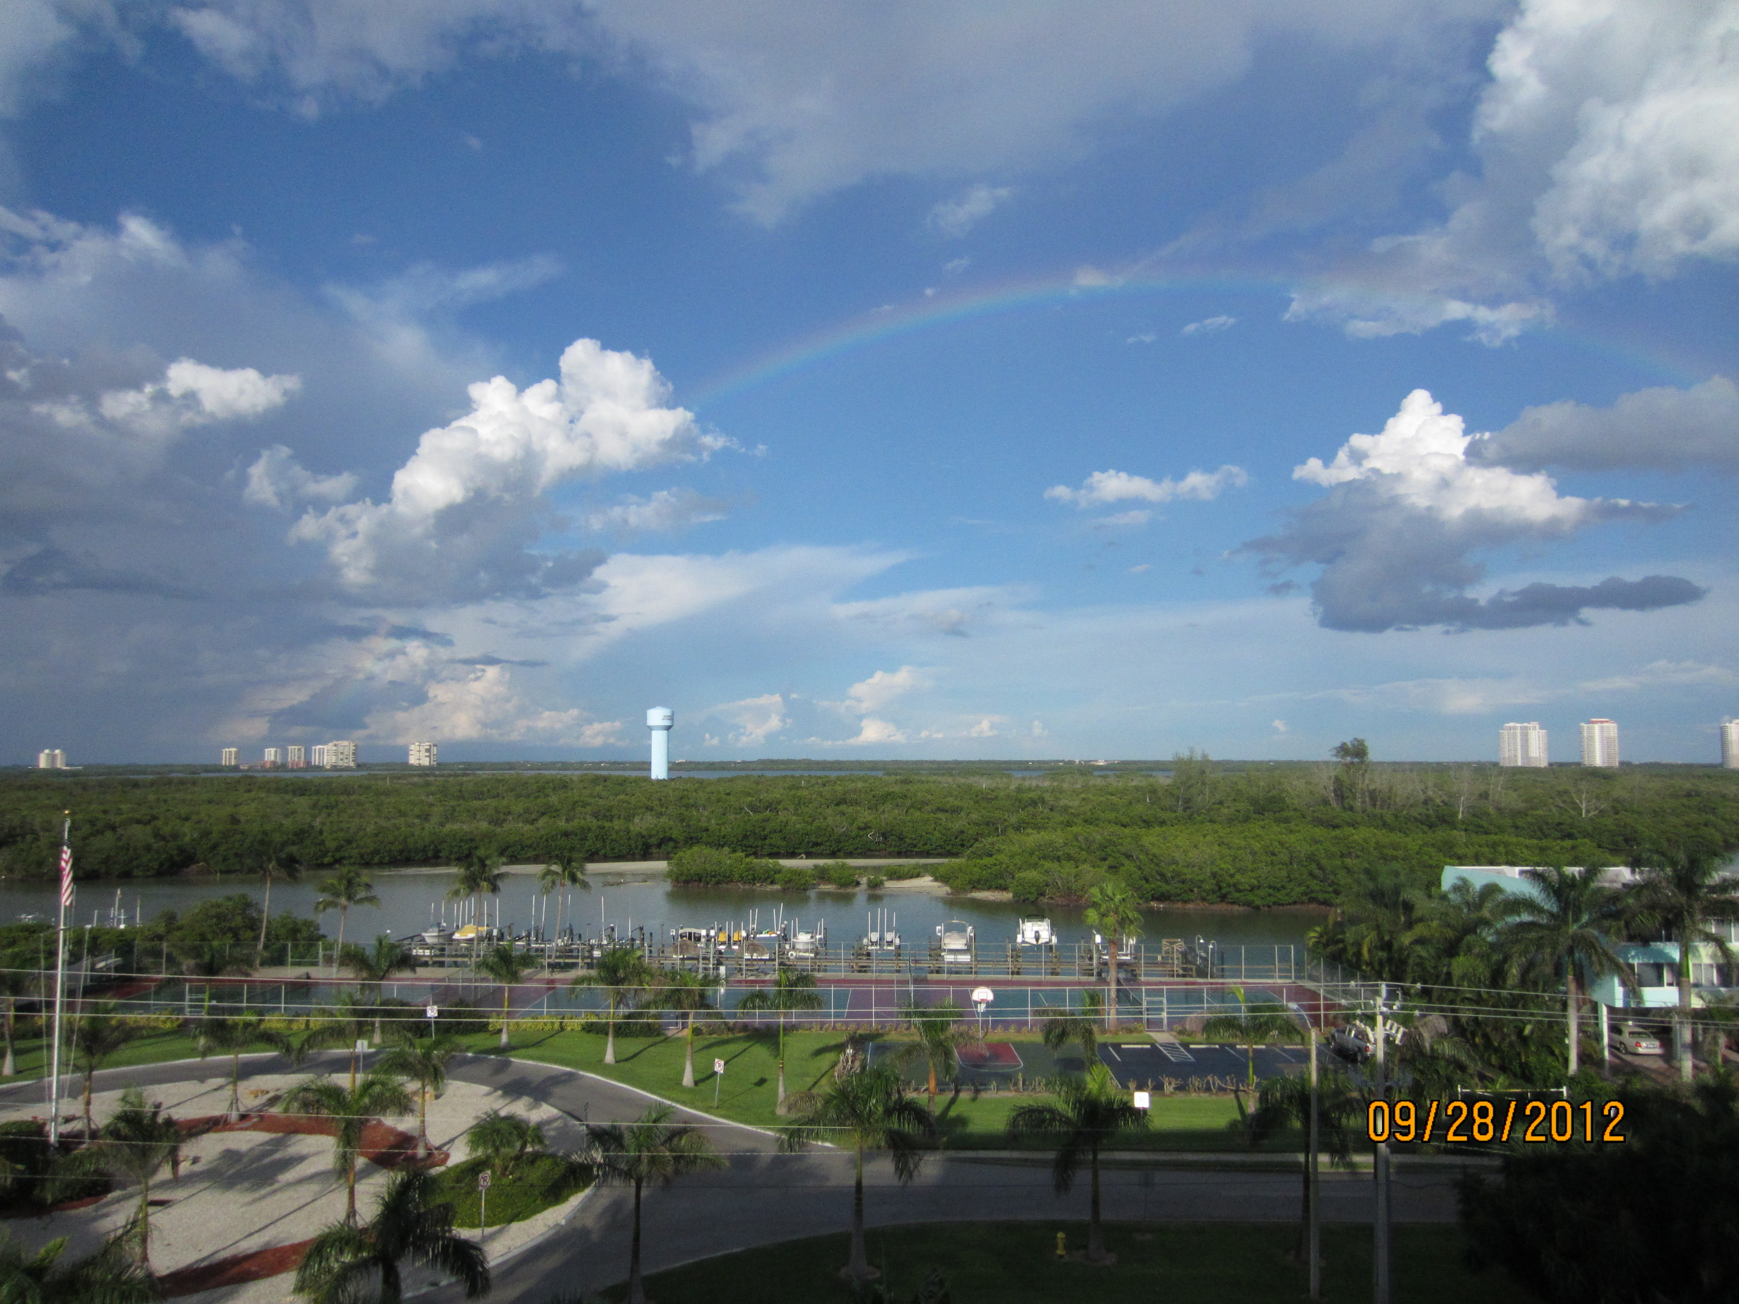
Bay view from my Condo

Slide 18

Professor Dave Jaye
Beihang University
Professor Dave Jaye
dave.jaye55@gmail.com
18
Notes:
What differences have you experienced?
18

